Slide 1

TOPIC:
CNN Image Classification
Presented By: Patricia Stanley
Intern Id: MST03-0053

Slide 2
Table of Contents:
Image Classification
CNN
CNN Layers
Activation Function and its types
Project Overview

Slide 3
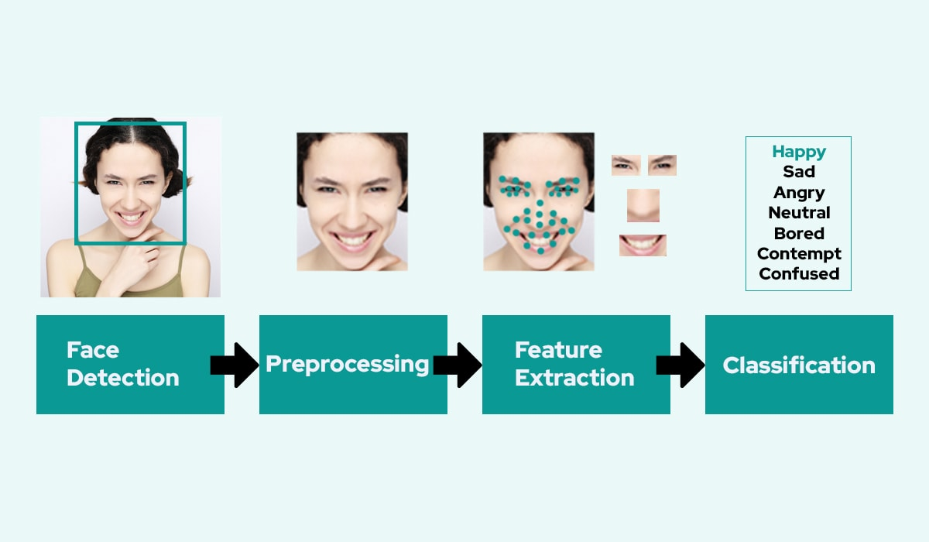
What is Image Classification?
Image classification is a task in computer vision where the goal is to categorize an image into one of several predefined classes or categories. The process involves using machine learning algorithms, typically deep learning models like convolutional neural networks (CNNs), to analyze the features of an image and make predictions about its class label. This technology is widely used in various applications such as facial recognition, autonomous driving, medical diagnostics, and more.

Slide 4
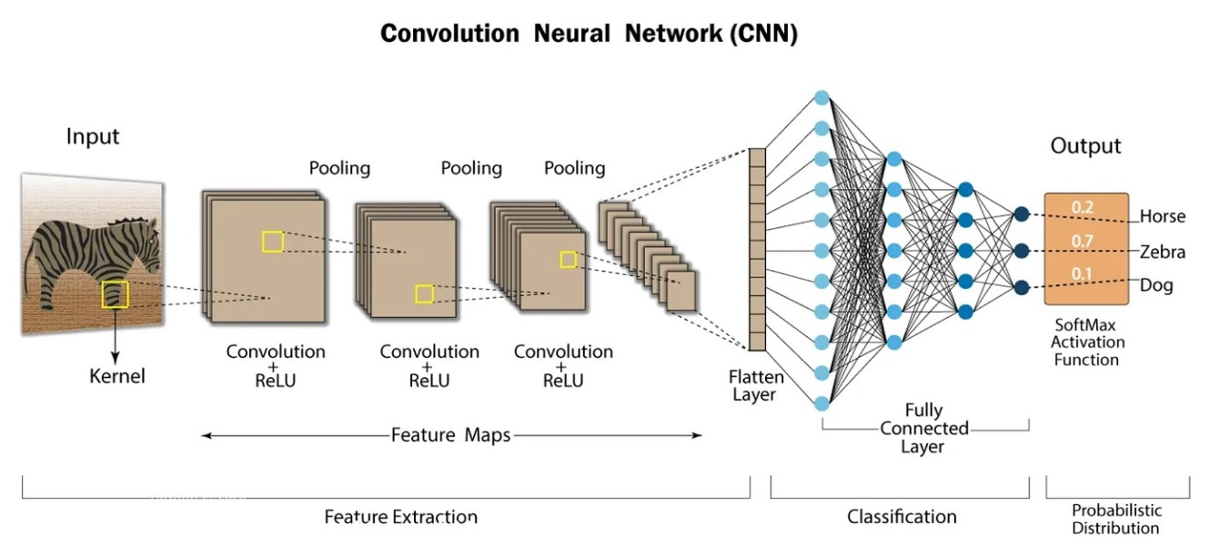
What are Convolutional Neural Network (CNN) ?
In deep learning, a convolutional neural network (CNN/ConvNet) is a class of deep neural networks, most commonly applied to analyze visual imagery. Convolutional networks use a process called convolution, which combines two functions to show how one changes the shape of the other.

Slide 5
LAYERS OF CONVOLUTIONAL NEURAL NETWORK:
Convolutional neural networks (CNNs) are a popular tool for image classification because of their hierarchical structure and ability to efficiently extract features from images. The layers in a CNN model are organized in three dimensions: depth, height, and width. Here are some layers that are commonly used in CNN models for image classification:
Convolutional layer
The first layer in a basic CNN model, which extracts features from input images and helps learn the relationship between pixels.
Max Pooling layer
Reduces the size of the feature maps from the previous convolutional layer. This layer can also help reduce computational cost and overfitting.
Fully connected layer
Also called a dense layer, this layer classifies images into different classes in the output layer.

Slide 6
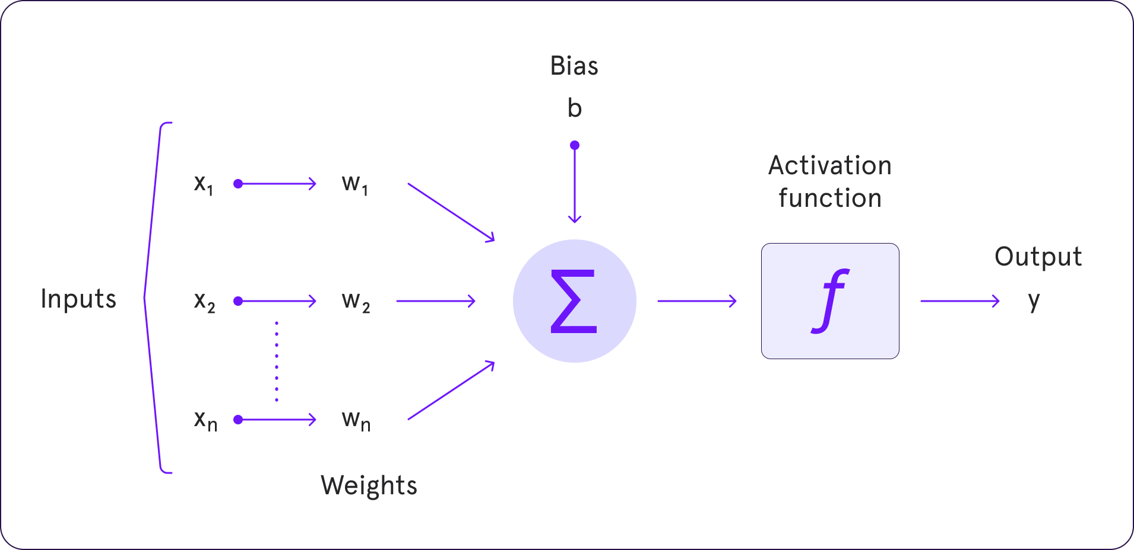
What is an Activation Function?
An activation function in the context of neural networks is a mathematical function applied to the output of a neuron. The purpose of an activation function is to introduce non-linearity into the model, allowing the network to learn and represent complex patterns in the data.
The activation function decides whether a neuron should be activated or not by calculating the weighted sum and further adding bias to it.

Slide 7
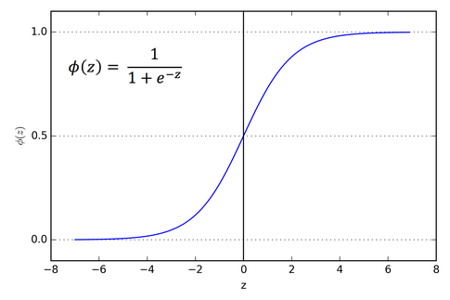
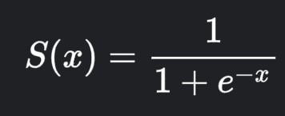
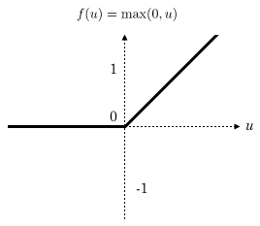
Types of Activation Functions:
Sigmoid Function (Logistic)
Formula:
Range: (0,1)
Properties: Smooth & continuous, output is squashed to a range between 0 and 1.
2.Rectified Linear Unit (ReLU):
Formula: ReLU(x)=max(0,x)
Range: [0,∞)
Properties: Simple and computationally efficient.

Slide 8
Phases:
Getting the data
Building the network
Model Testing
Preprocess Data Phase | CNN Phase
Preprocessing functions
Training the network

Slide 9
Project Overview:
Objective: Classify the images into “Happy” and “Sad” Categories using a Convolutional Neural Network(CNN).
Data Source: Images are stored in a directory, stored into subdirectories based on labels.
Tools Used: TensorFlow, OpenCV, Matplotlib, NumPy

Slide 10

About The Dataset:
The dataset used in this project consists of images categorized into two classes: 'Happy' and 'Sad'. These images are organized in a directory structure that is suitable for loading and processing using TensorFlow's image dataset utilities. Below is a detailed description of the dataset:
1. Directory Structure
Root Directory: Contains two subdirectories, one for each class ('Happy' and 'Sad').
2. Image Characteristics
Classes:
  Happy: Images of individuals with happy facial expressions.
  Sad: Images of individuals with sad facial expressions.
File Format: Images are typically in JPEG format (.jpg).
Dimensions: Images vary in size and resolution but are standardized to 256x256 pixels during preprocessing.

Slide 11
Build the Model:
A Sequential model is built using TensorFlow's Keras API. The architecture includes three convolutional layers followed by max pooling layers, a flattening layer, and two dense layers. The output layer uses a sigmoid activation function to predict the binary class (Happy or Sad).
Training the Model:
Data Splitting: The dataset is split into training, validation, and test sets in a 70-20-10 ratio. This ensures that the model can be trained and validated on separate data to evaluate its performance effectively.
The model is trained for 20 epochs with the Adam optimizer and binary cross-entropy loss. A TensorBoard callback is used for monitoring the training process.

Slide 12
THANK YOU
BY : Patricia Stanley

